Slide 1
पाठ.2. सच्चे मित्र
Text Book Bits From
pg.no.24 to pg.no.26

Slide 2



Page no. 24

Slide 3
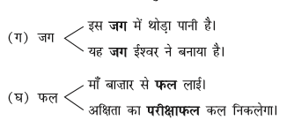


Page no.25

Slide 4
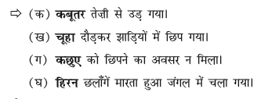
Page no.26

